Slide 1
Student Seminar: Exploiting Two Factor Authentication of Android and IOS
Robin Solignac
235020

Slide 2
1. Introduction: The 2 Factors Authentication Model

Slide 3
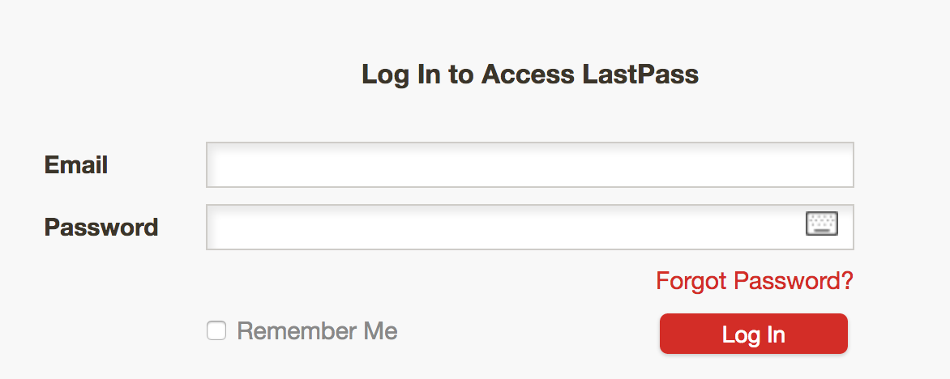
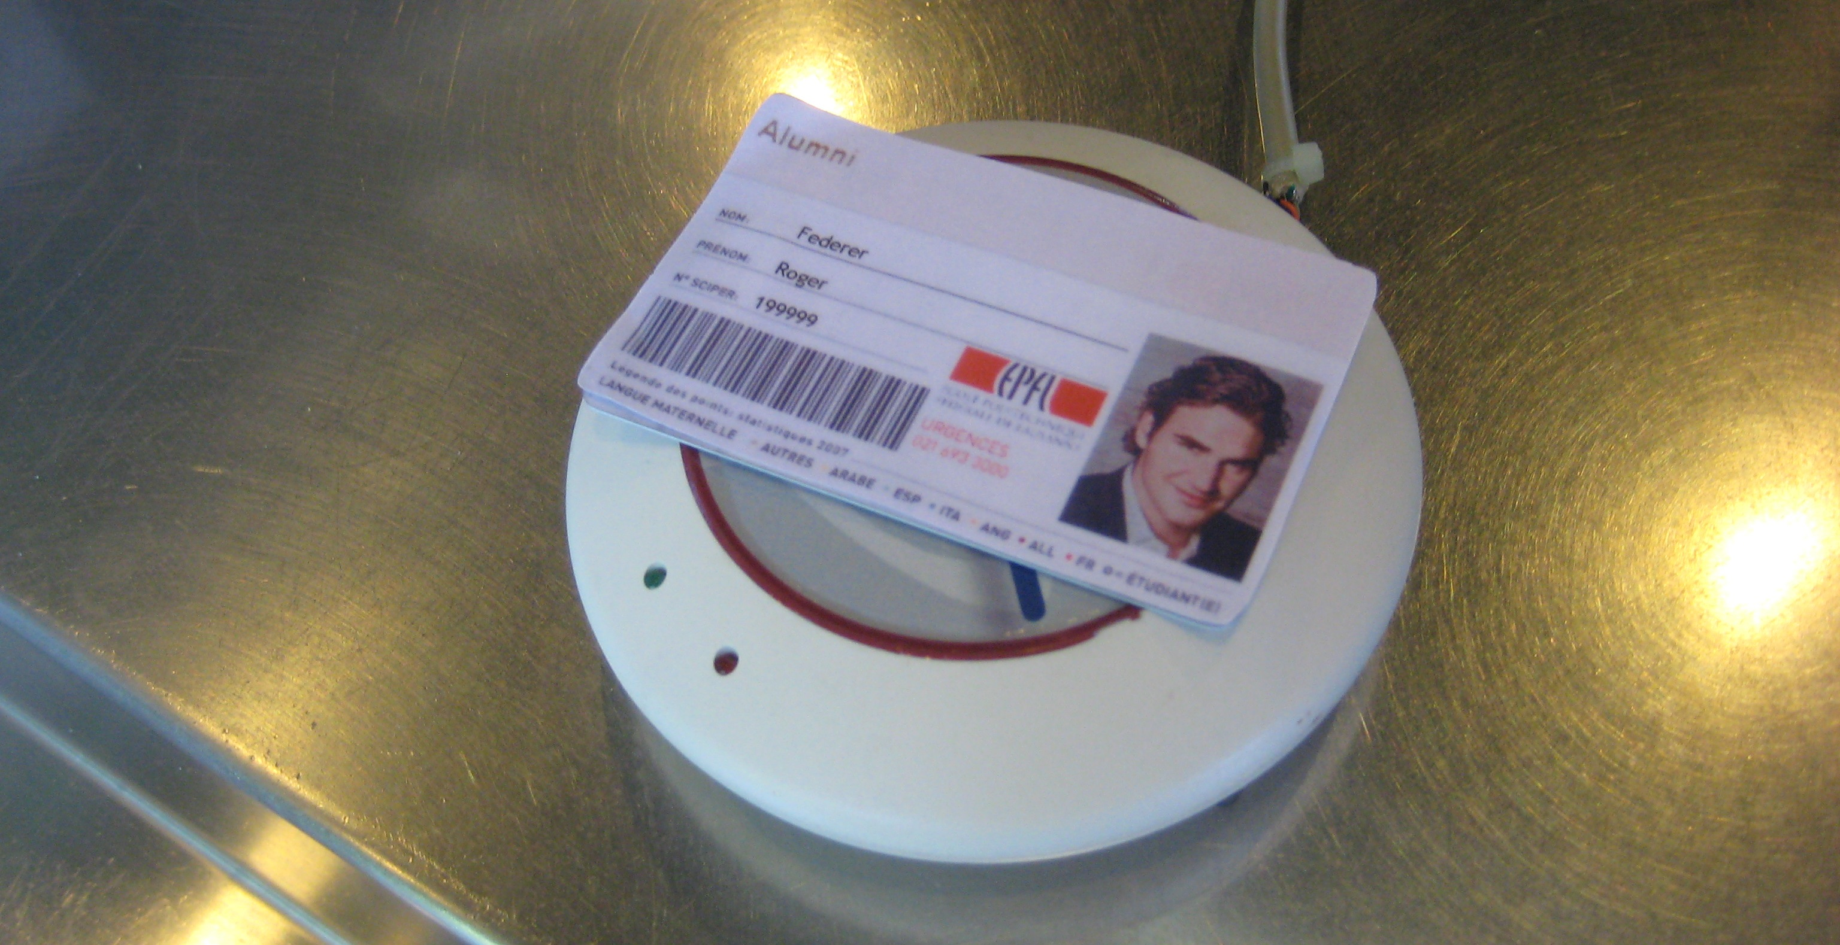
1. Presentation of 2FA model The concept
Combination of 2 access control in order to authenticate
Something you know + Something you have
Main goal: prevent authentication by third party in case of compromised password or main communication channel

Slide 4
1. Presentation of 2FA model The choice of smartphones
Majority of online modern 2FA use (smart)phone as “something you have”
Convenient: Don’t require the user to carry yet another card or devices
Available: Large majority of user have one
Reachable & Out of band: services can send message to it without using the main communication channel
Implement by Google, Microsoft, Amazon, Twitch, Twiter, Visa, Lastpass, …

Slide 5
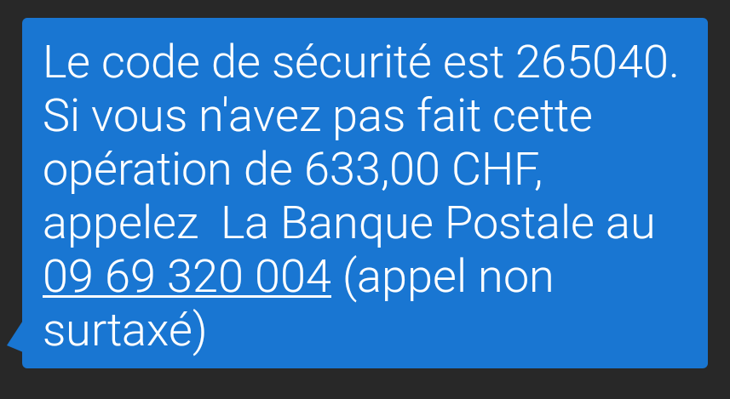
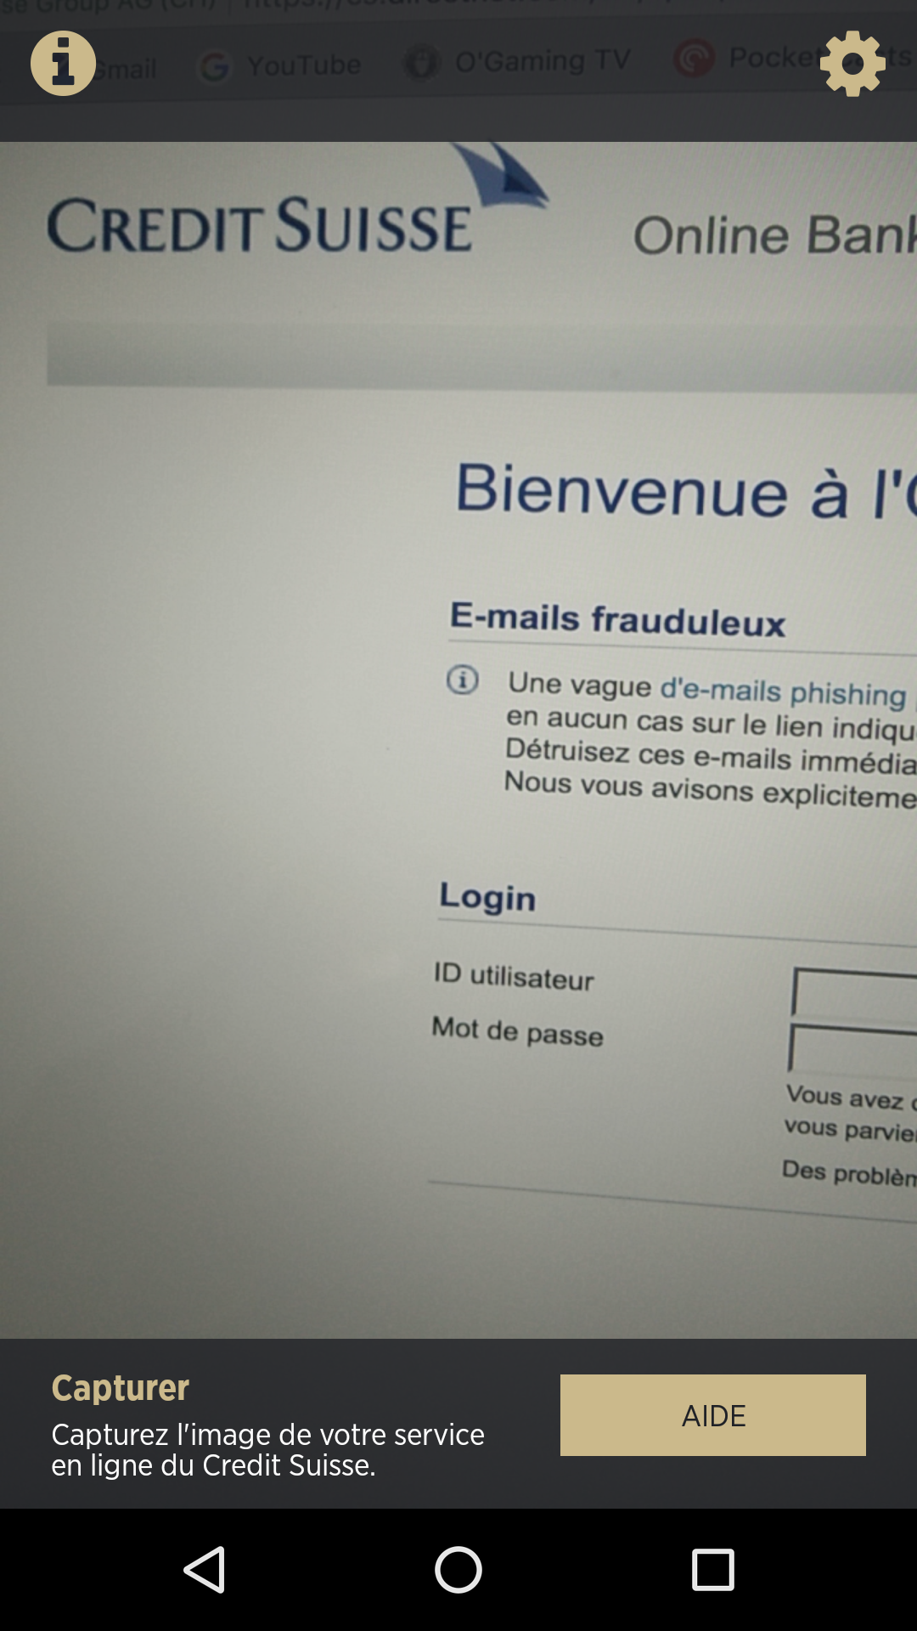
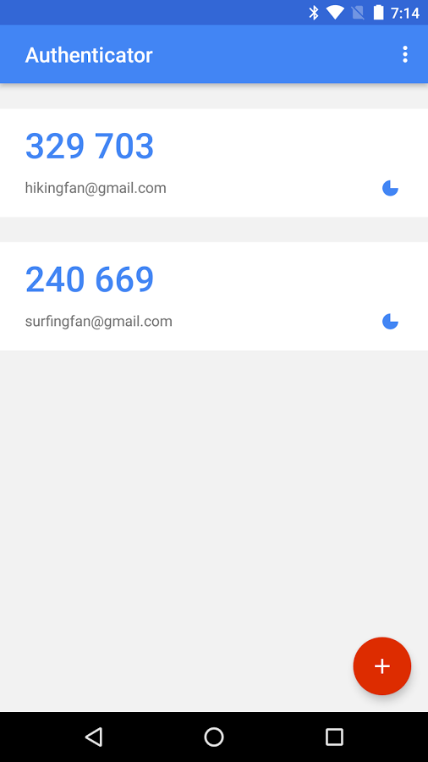
1. Presentation of 2FA model Smartphone 2FA implementation
SMS One Time Password (OTP)
Dedicated application
Can rely on OTP or not

Slide 6
Presentation of 2FA model

Slide 7
2. Key concepts

Slide 8
2. Key concepts Synchronization
Actions performed one devices will have impact on the other
Make use of the 2 smoother
Purposely implements by developers
Blur the line (Air-gap) between the two

Slide 9
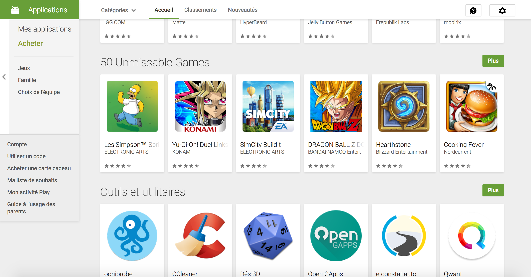
2. Key concepts Synchronization: Google play store website
Possibility to install, from the browser, applications on the phone
Need to be logged under the same Google account
Authorization also confirmed from the browser

Slide 10
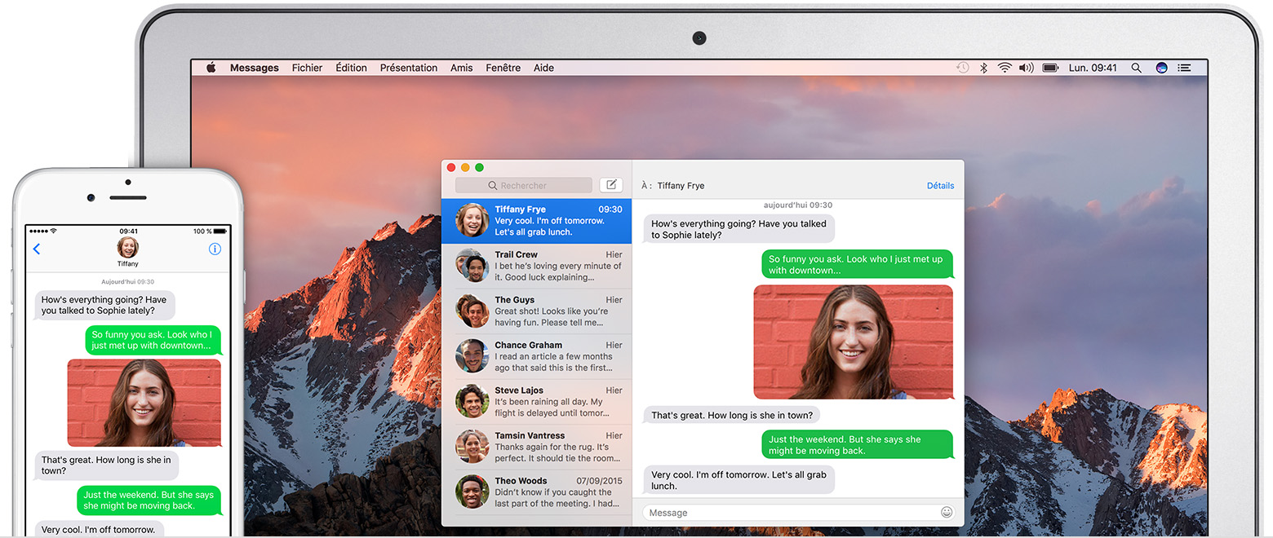
2. Key concepts Synchronization: Apple Continuity
If user posses an IPhone and a Mac, ability to send and read SMS and IMessages from the mac.
Message stored in clear on the mac
Off by default
Need to be on the same LAN

Slide 11

2. Key concepts Synchronization: Browser Sync
Synchronization of Bookmarks, history and open tabs between devices
Available on majority of popular browser
Sync if logged under the same user account

Slide 12
2. Key concepts MitB: Man in the browser attack
Stronger Variant of Man in Middle attack. the attacker can do everything a browser can.
Like man in the middle:
Read and modify all data exchanged
Send arbitrary data in the name of the user
Unlike man in the middle:
Read and modify encrypted data before encryption & after decryption
Read and modify browser related information: settings, cookies, bookmarks, history.

Slide 13
3. 2FA Attacks

Slide 14
3. 2FA Attacks The model
The PC is compromised (physically stolen, Malware, malicious plugin, …)
MitB attack is performed
Connection to the service is hijacked (via password or cookie)
To complete authentication (or transaction) OTP\TAN is send via SMS to victim phone
Phone is sane and run either on Android or Ios
Goal: steal the SMS

Slide 15
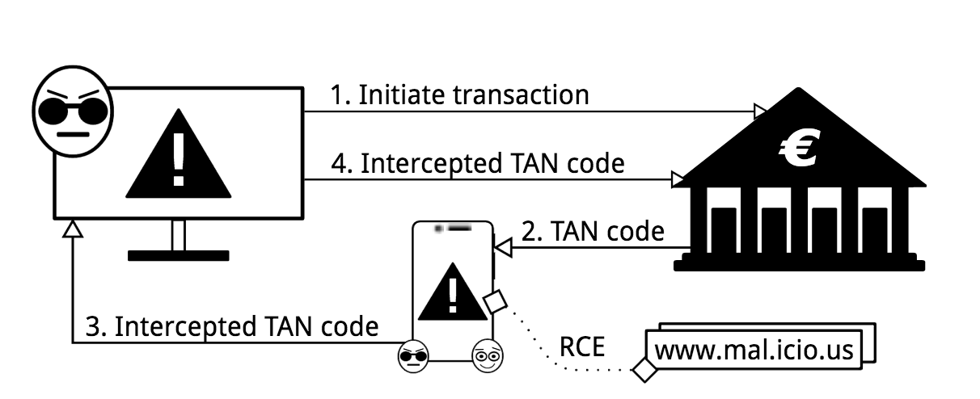
3. 2FA Attacks Android
Form MitB hijack Google session
Remotely Install SMS stealing app from playstore
App will forward OTP or TAN to attacker
2 difficulties:
Bypass Google Bouncer
Activate the app

Slide 16
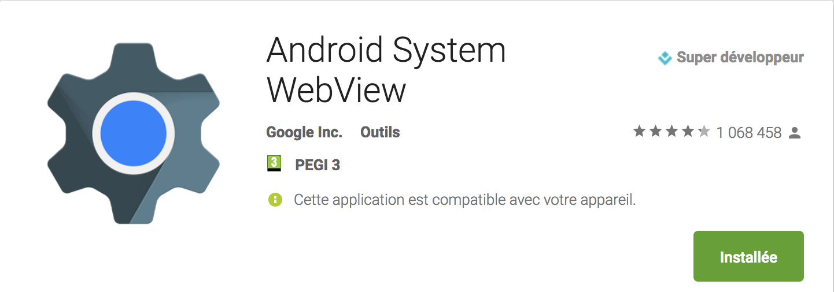
3. 2FA Attacks Android | Google Bouncer
Automated malware analysis tool deployed on Playstore
Analyses all uploaded apps
Static and dynamic analysis
Recent work show its easy to bypass.
Exemple: execute malicious code remotly via web-view

Slide 17
3. 2FA Attacks Android | App activation
Apps can’t be triggered by an external event (i.e SMS) until being opened for the 1st time
Need to trick user into opening it
Solution 1: clickbait title
Make user want to click on the notification

Slide 18
3. 2FA Attacks Android | App activation
Solution 2: Browser redirection activation
Webpages can trigger oppening of apps (i.e Twitter)
Modify all history, bookmarks and tabs to links who will trigger the app
This is consider as a valid first opening
Malicious app can then redirect to the original link
After activation:
rewrite all links to normal
Hide the app
http:\\mal.icio.us\proxy.php?url=<original_url>

Slide 19
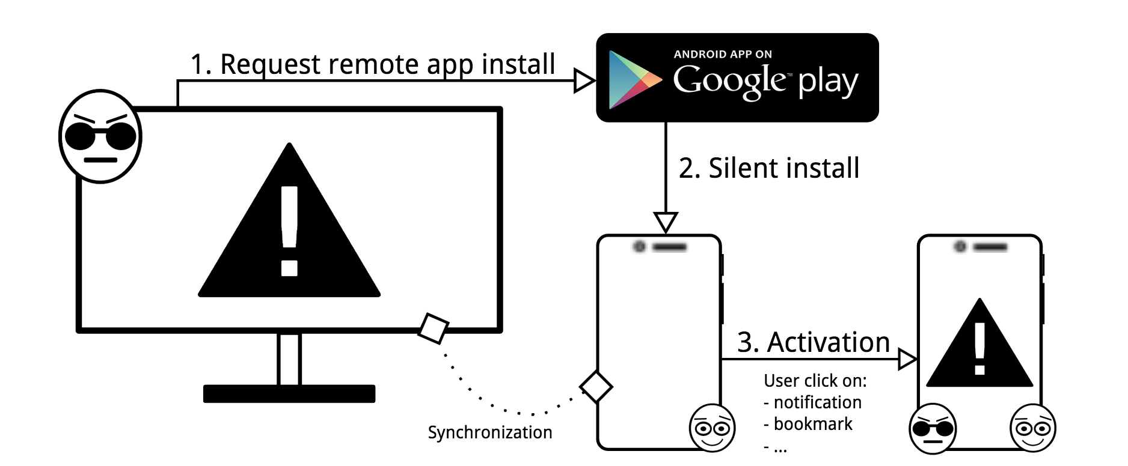
3. 2FA Attacks Android | Setup Summary

Slide 20
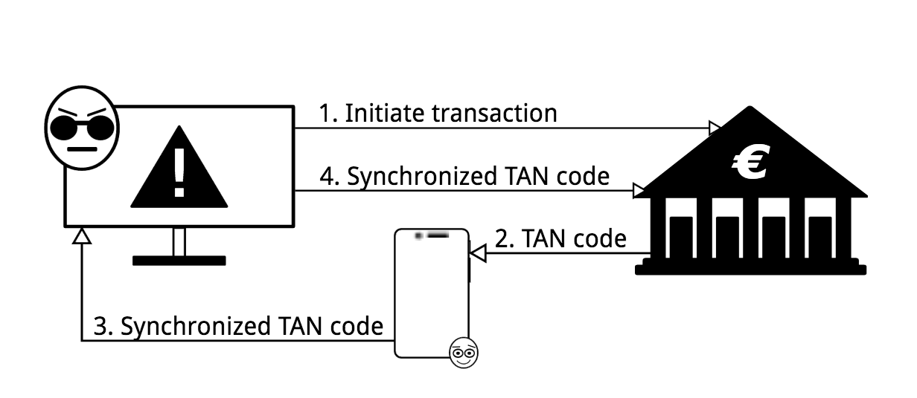
3. 2FA Attacks iOS
Since 2015 App can’t read SMS and notification
But if Continuity is activated:
All SMS are automatically send to the mac
Readable in clear by the browser

Slide 21
4. Discussion
Particularity, feasibility and solutions

Slide 22
4. Discussion An attack on assumption
After initial MitB infection, No use of bug or exploit
Only use features offered by Google and Apple
Hearth of the probleme:
such features reduce the air-gap
2FA assume the air-Gap

Slide 23
4. Discussion An attack on assumption

Slide 24
Presentation of 2FA model

Slide 25
Presentation of 2FA model

Slide 26
Presentation of 2FA model

Slide 27
Images sources
Epfl website: http://camipro.epfl.ch/paiement
Google Authenticator presentation on playstore : https://play.google.com/store/apps/details?id=com.google.android.apps.authenticator2
Apple website : https://support.apple.com/fr-ch/HT204681
Konoth et al. paper : http://fc16.ifca.ai/preproceedings/24_Konoth.pdf
Personal screenshots

